Slide 1


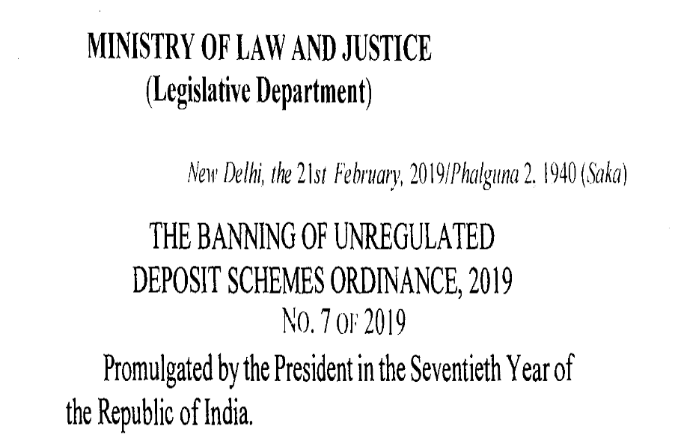
Harish V.S – Advocate
Partner – DNS Law House
Bangalore

Slide 2
ABOUT THE ORDINANCE
Passed in Lok Sabha on 13.02.2019.
Promulgated by the President of India on 21.02.2019.

Slide 3
VALIDITY
ARTICLE 123 OF THE CONSTITUITION OF INDIA
Cease to operate at the expiration of the stipulated period
Before the expiry of the stipulated period, if resolutions disapproving it are passed by both the Houses

Slide 4
STIPULATED PERIOD
ARTICLE 85 OF THE CONSTITUITION OF INDIA
17th Session of Parliament ended on 13.02.2019.
Next session should commence on or before 12.08.2019.
Bill shall be passed on or before 23.09.2019

Slide 5
STATEMENT OF OBJECTS AND REASONS
A Comprehensive mechanism
To Ban the Unregulated Deposit Schemes
To protect the interest of depositors and for matters connected therewith

Slide 6
SCHEME OF THE ACT
– AN OVERVIEW
complete prohibition of unregulated deposit taking activity;
deterrent punishment for promoting or operating an unregulated deposit taking scheme;
stringent punishment for fraudulent default in repayment to depositors;
designation of a Competent Authority by the State Government to ensure repayment of deposits in the event of default by a deposit taking establishment;

Slide 7
SCHEME OF THE ACT
– AN OVERVIEW
powers and functions of the competent authority including the power to attach assets of a defaulting establishment;
designation of Courts to oversee repayment of depositors and to try offences under the Act; and
listing of Regulated Deposit Schemes, with a clause enabling the Central Government to expand or prune the list.

Slide 8
DEFINITIONS
in respect of a company, the expression “deposit” shall have the same meaning as assigned to it under the Companies Act, 2013;
in respect of a non-banking financial company registered under the Reserve Bank of India Act, 1934, the expression “deposit” shall have the same meaning as assigned to it in clause (bb) of section 45-I of the said Act;

Slide 9
DEFINITIONS
Cont..2
Companies Act
Ordinance
Means amount of money received
By way of an advance or loan or any other form
With a promise to return
Whether after a specified period or otherwise
Either in cash or in kind or in any other form of a specified service
With or without any interest, bonus, profit or in any other form.
Includes any receipt of money
By way of deposit or loan or in any other form

Slide 10
DEFINITIONS Cont…3
Companies Act
Ordinance
Applicable only to Companies
“Deposit Taker” defined
Any individual of a group of Individuals
a proprietorship concern;
a partnership firm (whether registered or not);

Slide 11
DEFINITIONS Cont…4
Ordinance
a limited liability partnership registered under the Limited Liability
Partnership Act, 2008;
a company;
an association of persons
a trust (being a private trust governed under the provisions of the Indian Trusts Act, 1882 or a public trust, whether registered or not);
a co-operative society or a multi-State co-operative society; or

Slide 12
DEFINITIONS Cont…5
Ordinance
any other arrangement of whatsoever nature, receiving or soliciting deposits,
but does not include—
  (i) a Corporation incorporated under an Act of Parliament or a State Legislature;
  (ii) a banking company, a corresponding new bank, the State Bank of India, a subsidiary bank, a regional rural bank, a co-operative bank or a multi-state co-operative bank as defined in the Banking Regulation Act,1949;

Slide 13
Exclusions
Companies Act
Ordinance
Loans or facility from banks;
Loans from Public Financial Institutions / Insurance Companies;
any amount received by a company from any other company;
amounts received as loan from a scheduled bank or a co-operative bank or any other banking company as defined in section 5 of the Banking Regulation Act, 1949
amounts received by way of contributions towards the capital by partners of any partnership firm or a limited liability partnership
amounts received by an individual by way of loan from his relatives or amounts received by any firm by way of loan from the relatives of any of its partners

Slide 14
Exclusions Cont…2
Companies Act
Any amount received through Public offer. However, if securities not allotted within 60 days and refund not made within 15 days then such amount will be treated as Deposit;
Any amount received from the director of the company and in case of private company also from the relative of the director of the company subject to the condition that the amount has been given from own’s fund and not from borrowings
Any amount raised by the issue of bonds or debentures secured by a first charge or a charge ranking pari passu with the first charge, compulsorily convertible within 10 years
Non-interest-bearing security deposit from employee of the company under the contract of employment to the extent not exceeding his annual salary

Slide 15
Exclusions Cont…3
Companies Act
Any non-interest bearing amount received and held in trust
As advance towards consideration for future warranty or maintenance contract
Any amount received by way of subscription in respect of a chit under the Chit Fund Act, 1982
Any amount received by the company under any collective investment scheme
Any amount received by a company from registered Alternate Investment Funds, Domestic Venture Capital Funds, Infrastructure Investment Trusts and Mutual Funds.

Slide 16
Exclusions Cont…4
Companies Act
Ordinance
Any amount received in the course of business –
  As advance for supply of goods or services provided that such goods or services are supplied within 365 days of the receipt of advance;
an amount received in the course of, or for the purpose of, business and bearing a genuine connection to such business including –
  payment, advance or part payment for the supply or hire of goods or provision of services and is repayable in the event the goods or services are not in fact sold, hired or otherwise provided;

Slide 17
Exclusions Cont…5
Ordinance
Companies Act
As advance in connection with consideration for an immovable property provided such advance is adjusted against such property in accordance with the terms of the agreement;
  advance received in connection with consideration of an immovable property under an agreement or arrangement subject to the condition that such advance is adjusted against such immovable property as specified in terms of the agreement or arrangement;

Slide 18
Exclusions Cont…6
Companies Act
Ordinance
As security deposit for the performance of the contract;
As advance under long term projects for supply of capital goods;
security or dealership deposited for the performance of the contract for supply of goods or provision of services; or
an advance under the long-term projects for supply of capital goods except those specified in item above

Slide 19
Exclusions Cont…7
Companies Act
Ordinance
Provided that if the amounts received under items (i) to (iv) become refundable, such amounts shall be deemed to be deposits on the expiry of fifteen days from the date on which they become due for refund:
Provided further that where the said amounts become refundable, due to the deposit taker not obtaining necessary permission or approval under the law for the time being in force, wherever required, to deal in the goods or properties or services for which money is taken, such amounts shall be deemed to be deposits.
Provided that if the amount received under (a), (b) & (d) becomes refundable due to lack of necessary permission or approval to deal in the concerned goods or services, then the amount received shall be deemed as deposit on the expiry of 15 days from the date they become due for refund.

Slide 20
Exclusions Cont…8
“Regulated Deposit Scheme” means the Schemes specified under column (3) of the First Schedule;
SEBI
Scheme / Arrangement carried out by a Collective Investment Management Company, registered with SEBI under the SEBI (CIS) Regulations;
RBI
Deposits accepted by NBFCs registered with RBI.
Funds accepted by Individuals or entities engaged as Business Correspondents and Facilitators by Banks
IREDA – Insurance Regulatory and Development Authority of India.
Scheme offered by a Co-operative Society..
Chits with the previous sanction of the State Government in accordance with the provisions of Chit Fund Act.

Slide 21
Exclusions Cont…9
Scheme relating to money lending regulated by an enactment.
Scheme of Prize Chit / Money Circulation Scheme under the Prize Chits and Money Circulation Scheme (Banning) Act.
(a) Deposits accepted under any scheme or an arrangement registered with any regulatory body in India constituted or established under a Statute; and
(b) any other scheme as may be notified by the Central Government under this Act.

Slide 22
PROHIBITIONS
Unregulated Deposit Schemes shall be banned
No Deposit Taker shall directly or indirectly
  Shall not Promote, operate, issue any advertisement soliciting participation or enrolment
  Shall not Accept deposit in pursuance of an Unregulated Deposit Scheme
  Shall not commit any fraudulent default in the repayment or return of deposit on maturity
  Shall not commit any fraudulent default in rendering any specified service promised against such deposit
No person shall knowingly make any statement, promise or forecast which is false, deceptive or misleading in material facts
Deliberately conceal material facts

Slide 23
PROHIBITIONS Cont …2
To induce another person to invest in, or become a member or participant of any Unregulated Deposit Scheme
Prize chit or money Circulation Scheme banned under the Provisions of Prize Chits and Money Circulation Scheme (Banning) Act, 1978, deemed to be an Unregulated Deposit Scheme.
To fall within the purview of Money Circulation Scheme,
Element of chance or speculation
Hon’ble High Court of Delhi
Lambert Kreger Vs NCT of Delhi
Dependant on happening of an event or any contingency
Hon’ble High Court of Madras
Ponnusamy Vs State of Tamil Nadu

Slide 24
POWERS OF AUTHORITIES
Officers shall be appointed by the State Government.
When an Officer has reason to believe that any deposit taker is soliciting Unregulated Deposit
Provisionally attach the deposits held by the Deposit Taker and the money or other property acquired either in the name of the deposit taker or in the name of any other person on behalf of the deposit taker.
Summon any person
Impounding of records
Competent Authority shall share information with
  C B I
  Income Tax Department
  Police
  Banks

Slide 25
POWERS OF AUTHORITIES Cont…2
Attachment and sale of properties
Priority and precedence over any other debts / Taxes
Vesting of properties in the Competent Authority, upon attachment.
Taking possession of properties
Disposal of properties either in Public auction or a Private Sale
Completion of the proceedings within 180 days
Appeal to High Court within 60 days

Slide 26
OFFENCES / PUNISHMENTS
Sl. No. | Nature of offence | Imprisonment | Fine
1 | Soliciting Unregulated Deposit | 1 Year to 5 Years and fine | 2 Lakhs to 10 Lakhs
2 | Accepting Unregulated Deposit | 2 Years to 7 Years and fine | 3 Lakhs to 10 Lakhs
3 | Fraudulently defaults in repayment of Unregulated deposits | 3 Years to 10 Years and fine | 5 Lakhs to Twice the amount of deposits collected

Slide 27
OFFENCES / PUNISHMENTS Cont..2
Sl. No. | Nature of offence | Imprisonment | Fine
4 | Fraudulently defaults in repayment of Regulated Deposits | Upto 7 Years or fine | 5 Lakhs to 25 Crores or Three times the profits made out of the fraudulent default, whichever is higher or with both.
5 | False statement, promise or forecast made by any person, to induce another person to invest in Unregulated Deposit Scheme | 1 Years to 5 Years and fine | Upto 10 Lakhs

Slide 28
OFFENCES / PUNISHMENTS Cont..3
Sl. No. | Nature of offence | Imprisonment | Fine
6 | Second time conviction under the Ordinance | 5 Years to 10 Years and fine | 10 Lakhs to 50 Crores
7 | Failure to furnish any information / statements | No imprisonment | Upto 5 Lakhs

Slide 29
OFFENCES / PUNISHMENTS Cont..4
If an offence is committed by a deposit taker other than an individual, any director, manager, secretary, promoter, partner, employee or other officer of the deposit taker, shall be deemed to be guilty, if negligence is attributable to such person.

Slide 30
ROLE OF POLICE
Every offence except offences U/s. 22 and 26 shall be cognizable and non-bailable.
If the Offence relates to a Deposit Scheme, whether the depositors, deposit takers or properties involved in more than one State or UT or outside India and affect public interest significantly, matter shall be referred to CBI for investigation.
Search and seizure by Police Officer with prior written authorisation of SP / DCP.
Freezing of Bank accounts
Arrest
Designated Court shall be Court of Sessions

Slide 31
THANK YOU

Slide 32

Contact
HARISH V.S
Advocate
Partner – M/s. DNS Law House
No.36, 3rd Floor, 2nd Cross
Kumarapark West
Bangalore-560 020.
  Email :
  lawguru.harish@gmail.com
  harish@dnslawhouse.net
Mobile : 94483 88274

